Slide 1
Edmonds Can Do Better
Overview

Slide 2
We will continue to receive Fire & EMS services if we vote NO
A contract extension has been negotiated

Slide 3
How did we get here?
South County Fire unilaterally terminated our contract early without cause
Why did we get here?
Edmonds is attractive to the RFA for our high tax base

Slide 4
Protect Local Control of …
Our service needs
Our tax dollars to directly benefit our community
Our voting power
Performance accountability
Future costs
Edmonds has unique needs – one size does not fit all

Slide 5
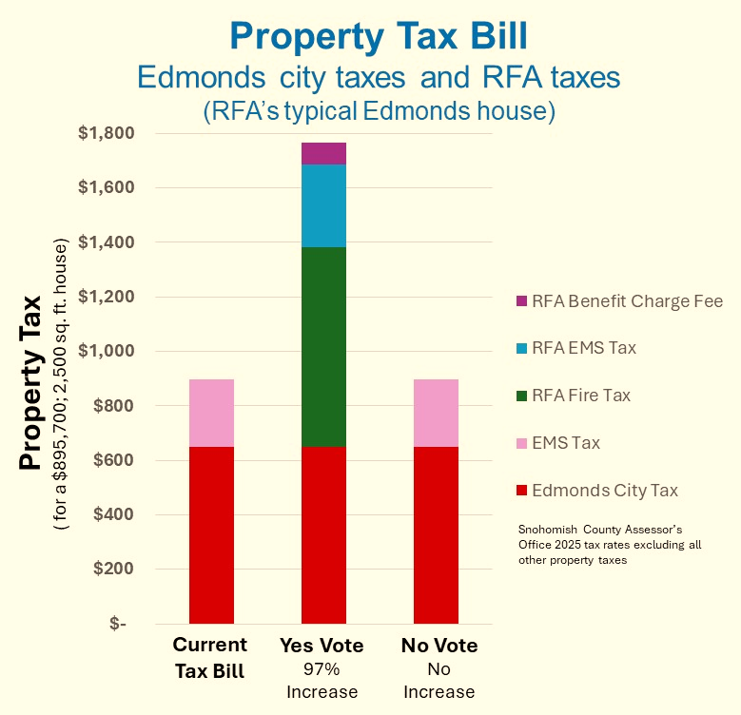
Higher Costs
Renters, homeowners and businesses will all feel the pain of a higher than needed tax increase

Slide 6
Protect our …
Seniors
Families
Homeowners
Renters
Small Businesses
… from excessive property tax increases

Slide 7
We have Many Options to Explore as a Community
Policy
Considerations
Service
Models
Financial
Measures
Administrative
Actions
Operational
Strategies
A NO vote provides time to minimize the tax impact

Slide 8
Hit the Pause Button Vote NO on Annexation
Edmondscandobetter.org

